Slide 1

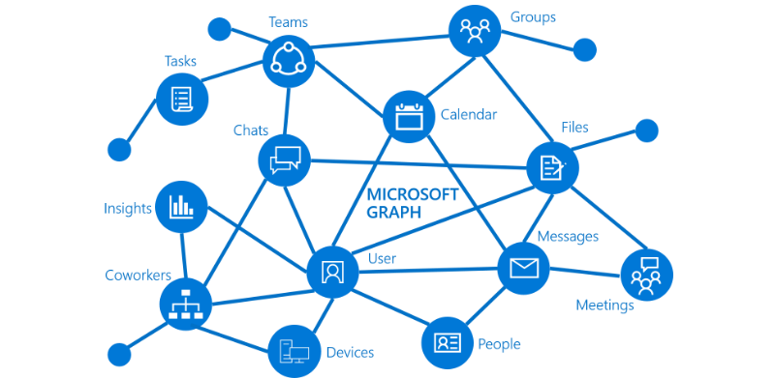
Presentation title
Microsoft Ignite
Speaker Name
Title
aka.ms/graph

Slide 2


Ignite Pre-Day Microsoft Graph + Azure Functions
Louis Maresca

Slide 3
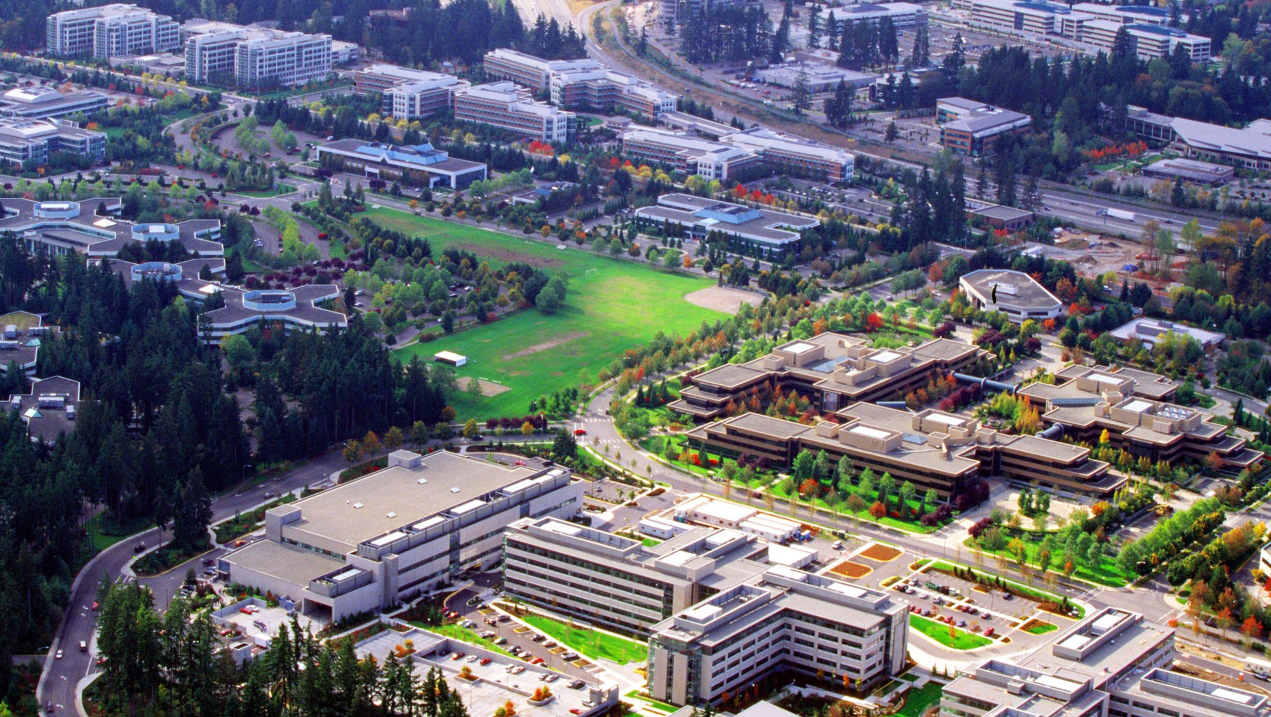



Story Time

Slide 4


Distributed, Sync, Merge, Commit!

Slide 5

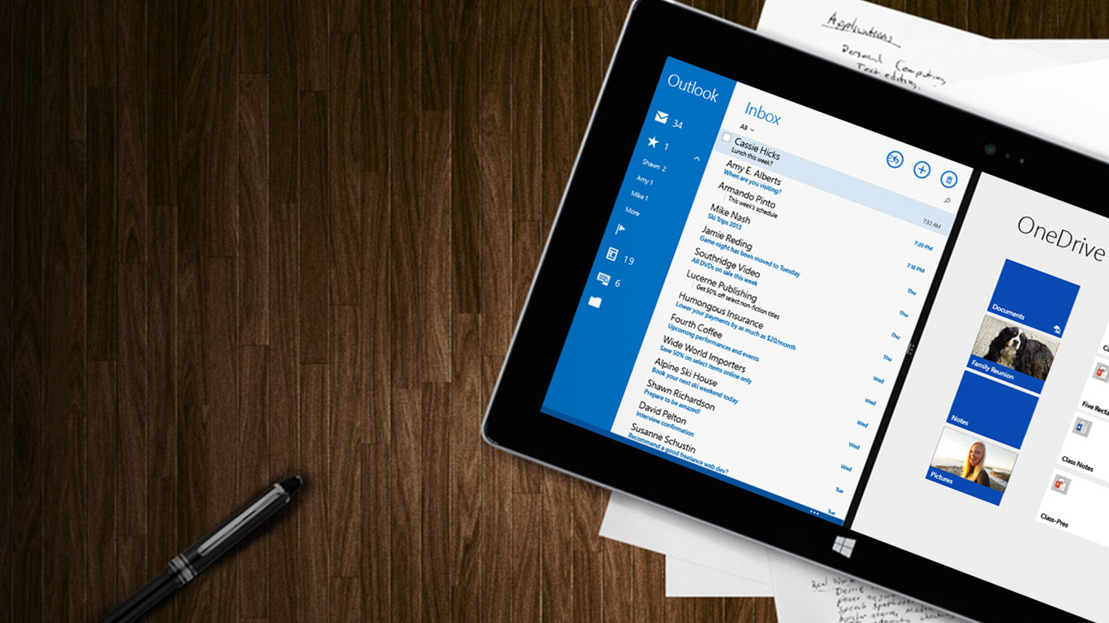

Slide 6



Slide 8

Older/Wiser
Graph pings Azure Functions when
event is created
Azure Function executes
with single event
Triggers an Create

Slide 9
Microsoft Graph Webhooks
Delivers notifications to clients
Subscribe to changes in messages, events, OneDrive, etc.
Events at any level - me/messages or me/mailfolders('inbox')/messages
Subscribe to event types created, updated, deleted
Notes:
-new employee in /beta

Slide 10

Have you had your coffee?
We are going to code…
public static async Task<HttpResponseMessage> Run(HttpRequestMessage req, TraceWriter log) { log.Info("C# HTTP trigger function processed a request."); // parse query parameter string name = req.GetQueryNameValuePairs() .FirstOrDefault(q => string.Compare(q.Key, "name", true) == 0) .Value;

Slide 11
What’s the plan?
What is Microsoft Graph?
Azure Functions and Serverless Computing
Combining the Graph and Functions
Now it’s your turn…

Slide 12
Microsoft Graph API
Access user, group and organizational data
One endpoint
One token
All users
Your app
https://graph.microsoft.com
Users
Groups
SharePoint
Outlook
OneNote
Planner
Teams
Excel
Intune
Azure AD
more…
Notes:
As a dev you don’t have to worry about where the data is stored
Single REST API for multiple Microsoft services
allows for easy traversal of objects and relationships
eliminates the need to discover endpoints
Consistent across
Only one OAuth access token needed
secure access with delegated permissions, no user name/password
For both personal and work and school accounts
Rome: devices and activities. publish and read user's activity & multi user sessions

Slide 13

Microsoft Graph
One Endpoint To rule them All
https://graph.microsoft.com/
Operation | Service endpoint
GET my profile | https://graph.microsoft.com/v1.0/me
GET my files | https://graph.microsoft.com/v1.0/me/drive/root/children
GET my photo | https://graph.microsoft.com/v1.0/me/photo/$value
GET my mail | https://graph.microsoft.com/v1.0/me/messages
GET my calendar | https://graph.microsoft.com/v1.0/me/calendar
GET my manager | https://graph.microsoft.com/v1.0/me/manager
GET last user to modify file foo.txt | https://graph.microsoft.com/v1.0/me/drive/root/children/foo.txt/lastModifiedByUser
GET users in my organization | https://graph.microsoft.com/v1.0/users
GET group conversations | https://graph.microsoft.com/v1.0/groups/<id>/conversations
GET people related to me | https://graph.microsoft.com/beta/me/people
GET my tasks | https://graph.microsoft.com/beta/me/tasks
GET my notes | https://graph.microsoft.com/beta/me/notes/notebooks
GET files trending around me | https://graph.microsoft.com/beta/me/trendingAround

Slide 14
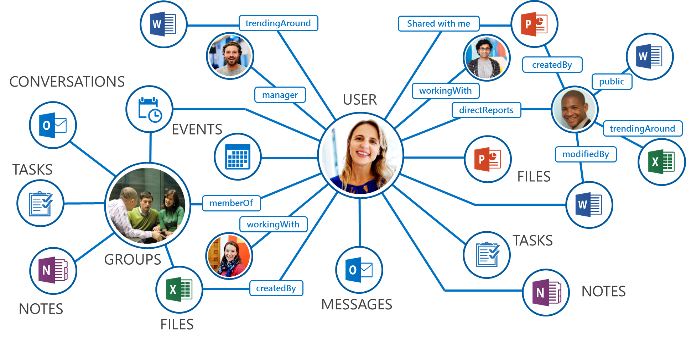
What is the Microsoft Graph?
Accessing data
/me
/me/events
/groups/<id>/conversations
/drives/<id>/
/worksheets(<id>)/charts
Traverse
/drive/items/<id>/ lastModifiedByUser
Getting insights
/me/trendingAround
/me/findMeetingTimes
Work/School + Personal
https://graph.microsoft.com/

Slide 15
Calling the API
HTTP verbs dictate the request intent: GET | POST | PATCH | PUT | DELETE
Version: /v1.0 or /beta
Resource: /users, /groups, /sites, /drives, /devices, more…
Member from collection: /users/AAA
Property: /users/AAA/department
Traverse to related resources via navigations: /users/AAA/events
Query parameters: /users/AAA/events?$top=5
Format results: $select | $orderby
Control results: $filter | $expand
Paging: $top | $skip | $skiptoken
https://graph.microsoft.com
/{version}
/{resource}
/{id}
/{property}
?{query-parameters}
Notes:
APIs are REST-based and you can call them using “with the web development tools, etc. that you use every day” (something in that vein

Slide 16
Demo – Graph Explorer
aka.ms/ge

Slide 17
Graph SDK – Object Model + Request builders
Want to experiment, jump start yourself
Each retrievable Entity has a ‘Request()’
proxy.Me.MailFolders.Inbox.Messages.Request().Select("")
Execute GetAsync() to call the Graph

Slide 18
Graph SDK – Wrapping OData
Replicates Odata semantics
SDK | OData
Select() | $select
Filter() | $filter
OrderBy() | $orderby
Expand() | $expand

Slide 19
Example
proxy.Me.Contacts.Request().Select("").Filter("CreateDateTime ge 2017-09-23").GetAsync();

Slide 20
What is Serverless?
$
Abstraction of servers
Event-driven/ instant scale
Micro-billing
Notes:
Abstraction of servers, infrastructure and configuration of operating system
Event-driven scale
Sub-second billing
Stateless
Serverless compute is a fully managed service. Some refer to it as Functions as a Service
OS and Framework patching is performed for you
There is zero administrative tasks and no need to manage any infrastructure
You just deploy your code (function) and it runs
Your code runs within seconds and for very short period of time
Serverless compute scales quickly (almost instantly) and vastly
Automatically scales within seconds
No scale configuration is required (there is no way to configure scale or limits)
Scales to match any given workload. Scales from zero to handle tens of thousands concurrent functions invocations within seconds
Pay only for the time your code is running
Serverless compute reacts to events
React, in near real-time, to events and triggers
Triggered by virtually any event from Azure service or 3rd party services
Setup time, provisioning is long & costly

Slide 21
Do more. Serverless.
DevOps Productivity
Focus on business logic
Faster time to market
Notes:
“Pinnacle of PaaS compute”
Not just hardware “servers”, but software servers are also managed for you
Focus on business logic, not solving technical problems not core to business
Lower effort to get started makes it easier to experiment (bots, etc.)
Benefits of “Serverless”

Slide 22
Applications
Example: Timer based processing
Eve
r
y 15 minutes
Find and clean invalid data
Clean table

Slide 23
Applications
Example: SaaS event processing
Excel file saved
Mic
r
os
o
f
t Graph API analyzes content
C
r
eates new sheets
to OneDrive
with cha
r
ts

Slide 24
Demo – Functions Demo
aka.ms/Tryfunctions

Slide 25
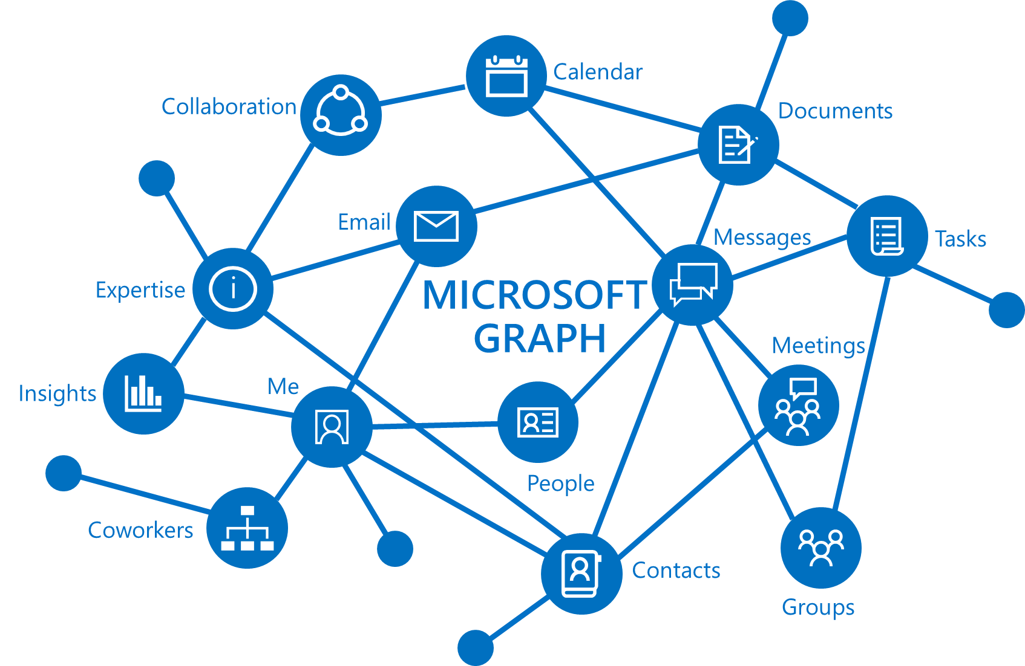
+
Notes:
DP

Slide 26
Your Challenge
HTTP Trigger Function App – Retrieves Email
Only retrieve email that have attachments
Use the REST or use the SDK
Get The Attachment
Stretch-Goal – Save the Attachment to OneDrive

Slide 27

Azure Functions + Microsoft Graph
Sales email with attached
documents come in.
Triggers a function
Saves the attachments
Notes:
-no database required

Slide 28


Solving that integration problem.
Where do you start?
aka.ms/functions

Slide 29
Resource Data
Azure Active Directory:
Client Id: 7cfce45c-6657-4979-a3aa-3783c62e1524
Token Audience:
https://[Your FuncName].azurewebsites.net/.auth/login/aad/callback
Secret: hE66/v+poB3ZvKWRtOHOU4qzsOg1VA6IsRfuUzbhjGw=

Slide 30

I am @LouMM on Twitter Principal Engineering Manager @ Microsoft Office Platform eXperience & API and SDK team

Slide 31
How were the docs? Let us know!
http://aka.ms/graphdocs

Slide 33
Data is spread across services
Azure Active Directory Graph API
graph.windows.net/contoso.com/users
graph.windows.net/contoso.com/groups
Windows Live profile API
apis.live.net/v5.0/me
SharePoint User Profile API
contoso.sharepoint.com/_api/SP.UserProfiles.PeopleManager/GetMyProperties
Outlook REST API
outlook.office.com/api/v2.0/me/Messages
outlook.office.com/api/v2.0/me/Events
OneDrive for Business API
contoso-my.sharepoint.com/personal
/yina_contoso_com/_api/v2.0/drive
contoso.sharepoint.com/sites
/designCouncil/_api/v2./drive
Office Graph in SharePoint Online
contoso.sharepoint.com/_api/search/query?Querytext='*'&Properties=
OneDrive API
https://api.onedrive.com/v1.0/drive

